Slide 1

Computer Graphics 3D Dispaly: Projection Lecture-13
Tapasy Rabeya Senior Lecturer
Department of Computer Science and Engineering Daffodil International University, DIU

Slide 2
Contents
3D Display
Definition & Types
Projection Types
Parallel Projection
Definition & Types
Perspective Projection
Definition & Types
Depth Cueing
Surface Rendering
‹#›

Slide 3
3D Display Methods
3D graphics deals with generating and displaying three dimensional objects in a two-dimensional space(eg: display screen).
In addition to color and brightness, a 3-D pixels adds a depth property that indicates where the point lies on the imaginary z-axis.
To generate realistic picture we have to first setup a coordinate reference for camera. This co-ordinate reference defines the position and orientation for the plane of the camera.
‹#›

Slide 4
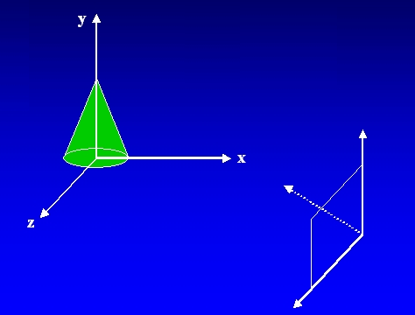
3D Display Methods Cntd
This plane used to display a view of the object
Object description has to transfer to the camera reference co-ordinates and projected onto the selected display plane.
‹#›

Slide 5
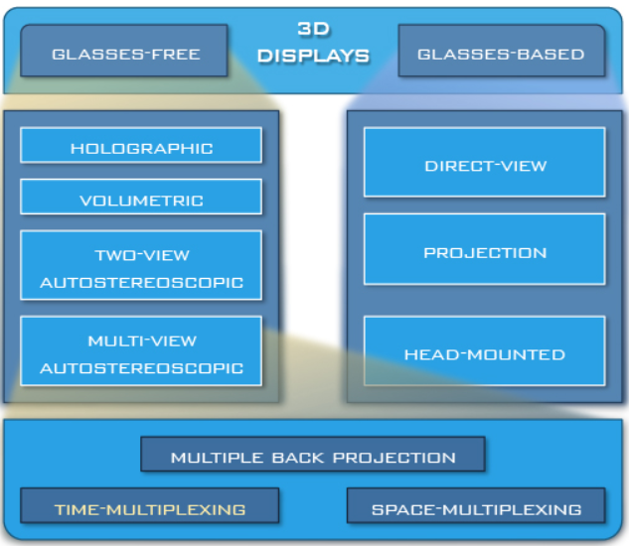
Types
‹#›

Slide 6
Projection
It is the process of converting a 3D object into a 2D object. It is also defined as mapping or transformation of the object in the projection plane or view plane. The view plane is displayed surface.
‹#›

Slide 7
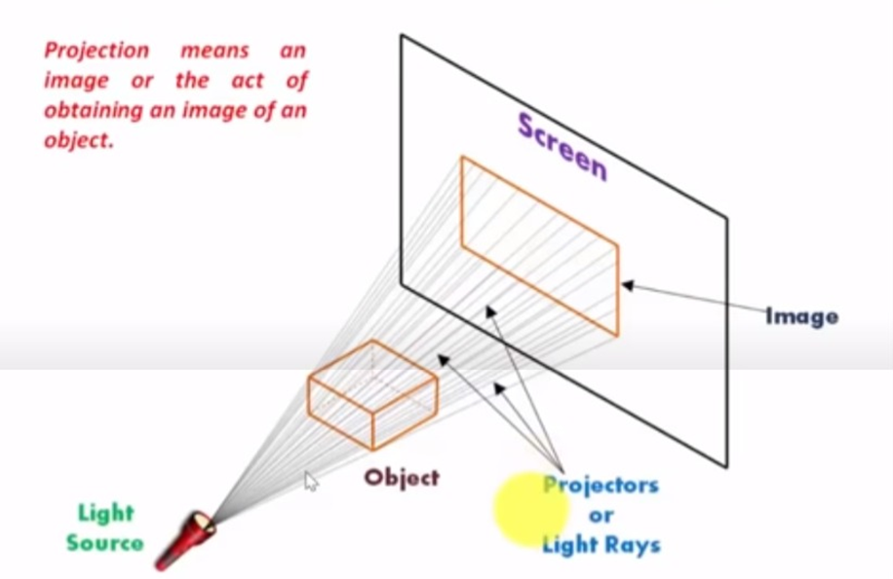
Projection
‹#›

Slide 8
Types of Projection
Transform 3D objects on to a 2D plane using projections
2 types of projections
Perspective
Parallel
‹#›

Slide 9
PROJECTIONS
PARALLEL
(parallel projectors)
PERSPECTIVE
(converging projectors)
One point
(one principal vanishing point)
Orthographic
(projectors perpendicular to view plane)
Oblique
(projectors not perpendicular to view plane)
Two point
(Two principal vanishing point)
Axonometric
(view plane not parallel to principal planes)
General
Multiview
(view plane parallel to principal planes)
Cavalier
Three point
(Three principal vanishing point)
Cabinet
Isometric
Dimetric
Trimetric
‹#›

Slide 10
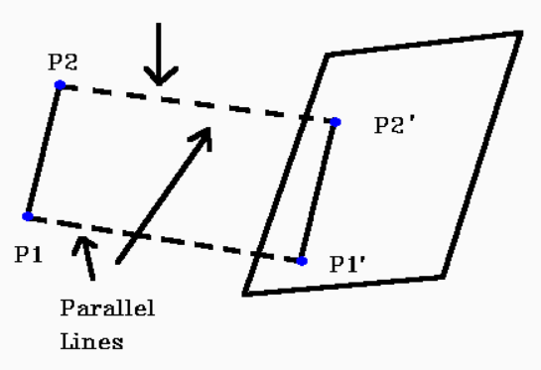
Parallel Projection
Discards z-coordinate and parallel lines from each vertex
Specify a direction of projection instead of center of projection
Project points on the object surface along parallel lines onto the display plane.
Parallel lines are still parallel after projection
‹#›

Slide 11
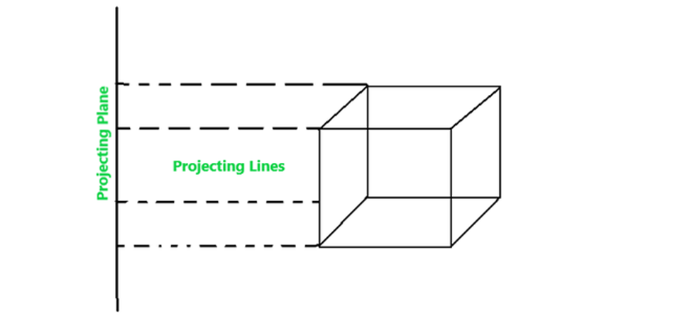
Parallel Projection
‹#›

Slide 12
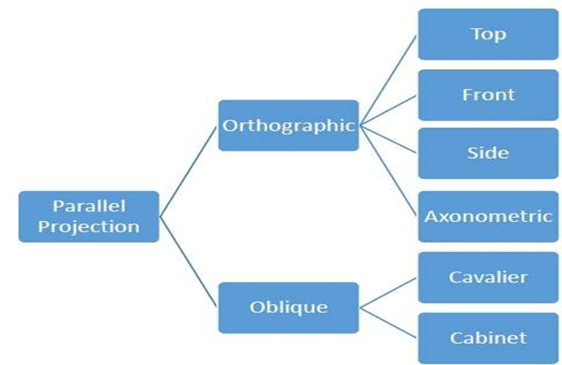
Parallel Projection: Types
‹#›

Slide 13
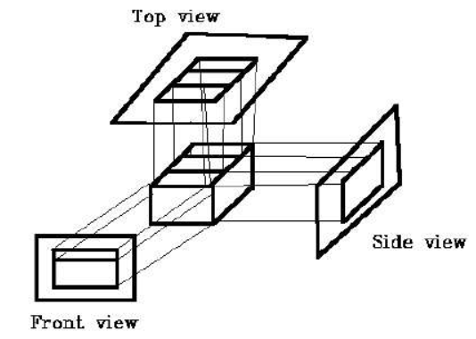
Parallel Projection: Types
1. Orthographic projection : If the direction of projection is perpendicular to the projection plane then it is an orthographic projection.
‹#›

Slide 14
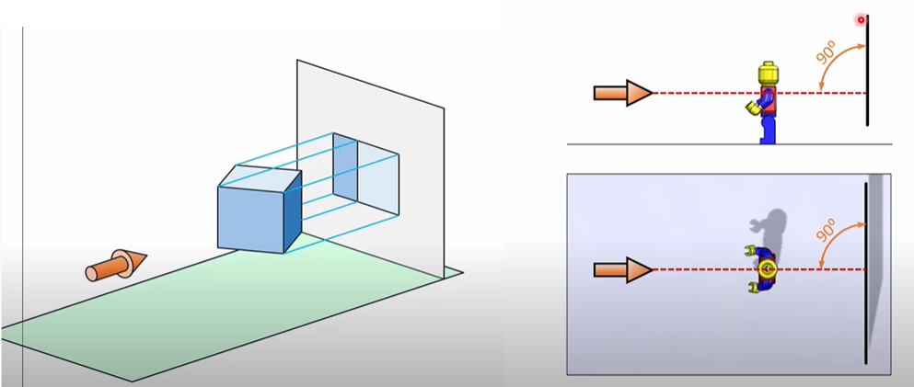
Orthographics Projection
‹#›

Slide 15
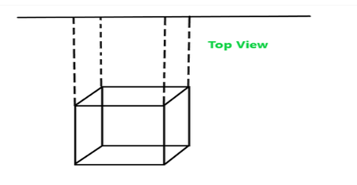
Orthographics Projection
Top-View : In this projection, the rays that emerge from the top of the polygon surface are observed.
‹#›

Slide 16
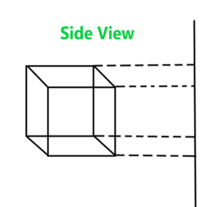
Orthographics Projection
Side-View : It is another type of projection orthographic projection where the side view of the polygon surface is observed.
‹#›

Slide 17
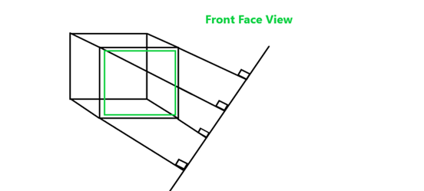
Orthographics Projection
Front-view : In this orthographic projection front face view of the object is observed.
‹#›

Slide 18
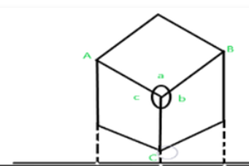
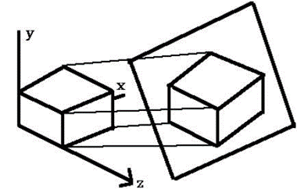
Orthographics Projection
The Axonometric Orthographic Projection is used to construct the pictorial representation of an object. The sight lines are perpendicular to the projection plane.
‹#›

Slide 19
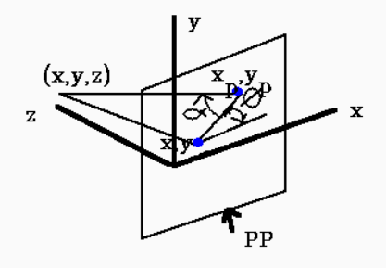
Parallel Projection: Types
2. Oblique projection : If the direction of projection is not perpendicular to the projection plane then it is an oblique projection.
‹#›

Slide 20
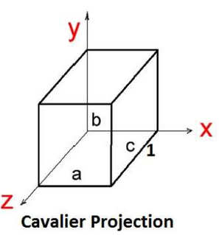
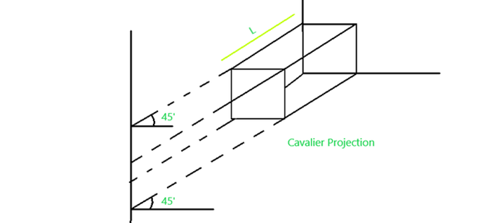
Oblique Projection: Types
Cavalier
The Cavalier projection makes 45° angle with the projection plane. The projection of a line perpendicular to the view plane has the same length as the line itself in Cavalier projection.
‹#›

Slide 21
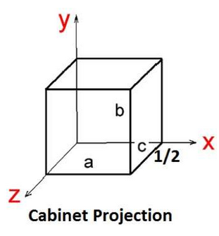
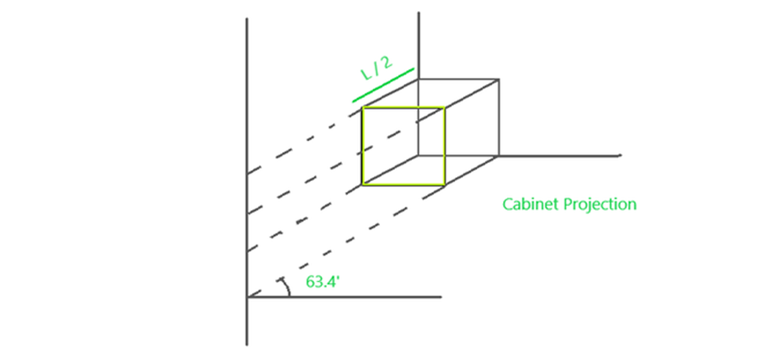
Oblique Projection: Types
Cabinet
The Cabinet projection makes 63.4° angle with the projection plane. In Cabinet projection, lines perpendicular to the viewing surface are projected at ½ their actual length.
‹#›

Slide 22
Perspective Projection
Project points to the display plane along converging paths.
This is the way that our eyes and a camera lens form images and so the displays are more realistic.
Parallel lines appear to converge to a distant point in the background.
Distant objects appear smaller than objects closer to the viewing position.
‹#›

Slide 23
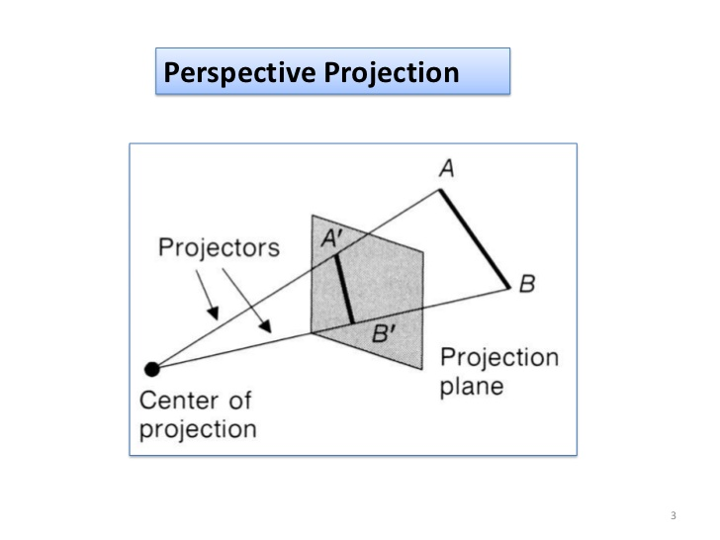
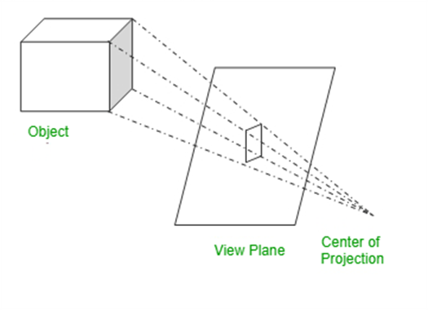
‹#›

Slide 24
Types
One point perspective projection is simple to draw.
Two point perspective projection gives better impression of depth.
Three point perspective projection is most difficult to draw.
‹#›

Slide 25
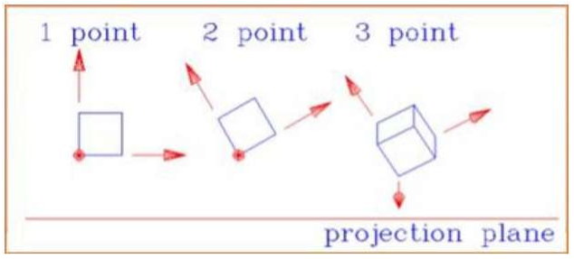
‹#›

Slide 26
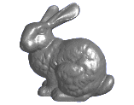
Perspective Projection
When we do 3-D graphics, we think of the screen as a 2-D window onto the 3-D world:
How tall should this bunny be?
‹#›

Slide 27
Perspective Projection
View plane
X
P (x, y, z)
(0,0,0)
x’ = ?
Z
d
‹#›

Slide 28
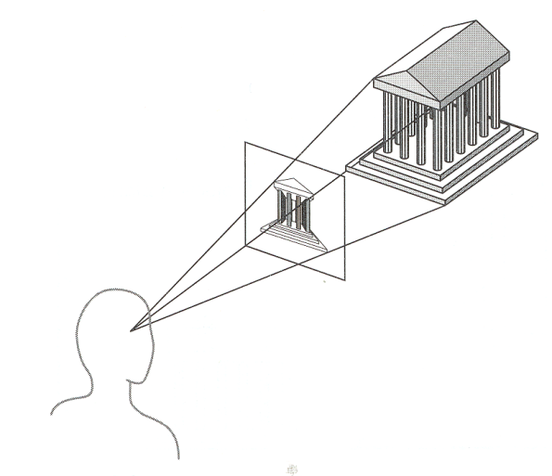
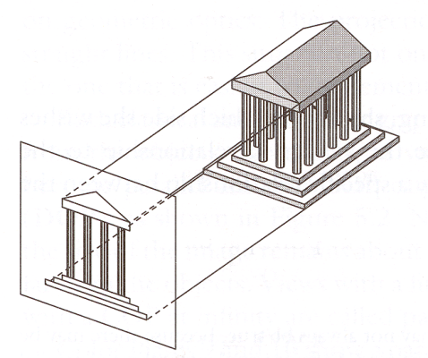
Perspective vs. Parallel
Perspective projection
Size varies inversely with distance - looks realistic
Distance and angles are not (in general) preserved
Parallel lines do not (in general) remain parallel
Parallel projection
Good for exact measurements
Parallel lines remain parallel
Angles are not (in general) preserved
Less realistic looking
‹#›

Slide 29

Vanishing point can be defined as a point in image plane where all parallel lines are interlinked. The Vanishing point is also called “Directing Point.”
‹#›

Slide 30
Use of Vanishing Point:
● It is used in 3D games and graphics editing. It is also used to represent 3D objects. We can also include perspective in the background of an image. We can also insert the shadow effect in an image.
‹#›

Slide 31
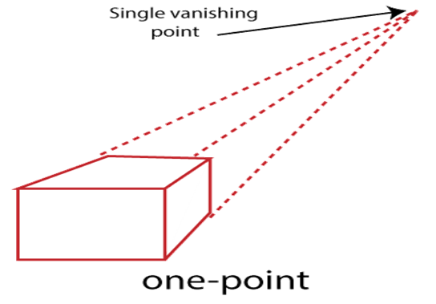
One Point: A One Point perspective contains only one vanishing point on the horizon line. It is easy to draw.
‹#›

Slide 32

Use of One Point– The One Point projection is mostly used to draw the images of roads, railway tracks, and buildings.
‹#›

Slide 33
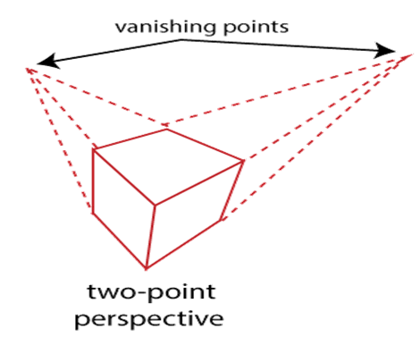
Two Point: It is also called “Angular Perspective.” A Two Point perspective contains two vanishing points on the line.
‹#›

Slide 34
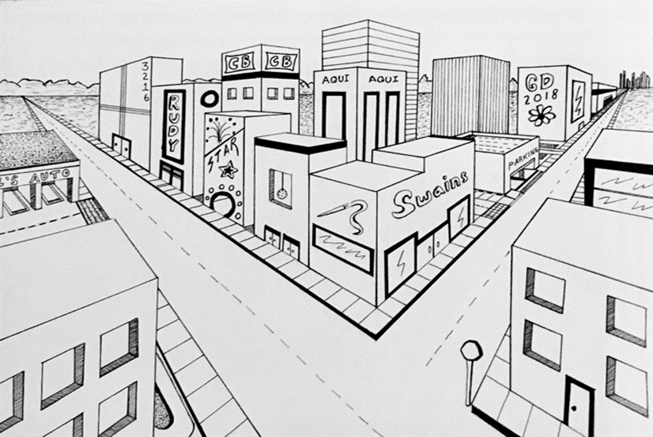
Use of Two Point– The main use of Two Point projection is to draw the two corner roads.
‹#›

Slide 35
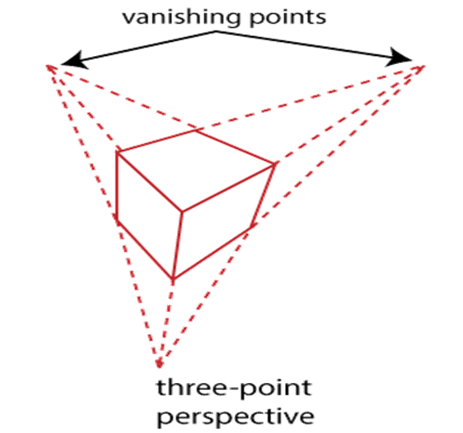
3.Three-Point– The Three-Point Perspective contains three vanishing points. Two points lie on the horizon line, and one above or below the line. It is very difficult to draw.
When we see an object from above, than the third point is below the ground. If we see an object from the below, than the third point is in the space above.
‹#›

Slide 36
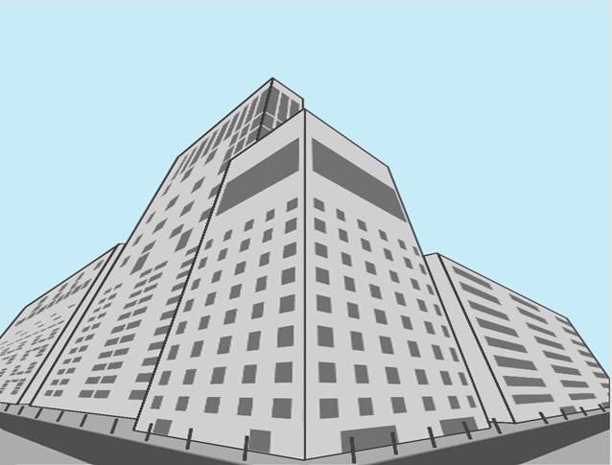
Use of Three-Point: It is mainly used in skyscraping.
‹#›

Slide 37
Thank You
‹#›

